Slide 1
The Result of Bancor Protocol Analysis
Kenny, Oct 5th

Slide 2
Bancor is flawed
The problem of “Double Coincidence of Wants” Bancor wants to solve might not exist in real world. Even assuming this problem does exist, Bancor protocol fails to ensure its superiority compared with normal market.
The price of smart token, i.e. currency in Bancor protocol could fluctuate significantly, especially when customers generate close valuations of smart token, which might generate destructive effect on market.
Bancor protocol cannot fully process multiple transaction orders that are launched simultaneously, especially when the market size is small.
1/18

Slide 3
Flawed Design of Bancor Protocol
One thoughtlessness stems from the frequent price fluctuation advo- cated by Bancor protocol, which might obstruct transactions in the market.
The second flaw of Bancor protocol is that it neglects the potential abnormal marketing behaviors of customers, which might bleed market’s reserve.
Bancor protocol aims to solve “Double Coincidence of Wants” problem, which actually might not be a problem in real-world market as no previous study evidence this problem’s existence.
2/18
Notes:
even assuming the “Double Coincidence of Wants” does exist, it is unsubstantiated to say it will cause damage to market order and customers’ benefits as Bancor does not show its superiority compared with normal market laws by solid experimental results.

Slide 4
3/18
Notes:
In synchronize step, the simulator will tell all customers the price of smart token in the current time step.
Last, we argued that the blue circle area should be pipelined in Bancor Market. Customers come into market by order. If one failed, he cannot get a second chance in this time slot to finish his transaction.

Slide 5
Classic Market Rules
4/18
Notes:
Blue plus red cancel
Red fail

Slide 6
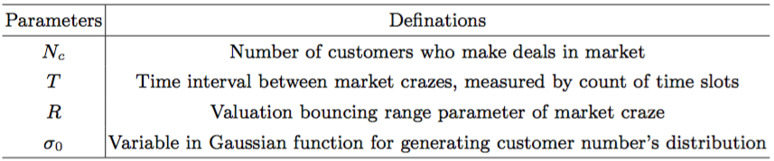
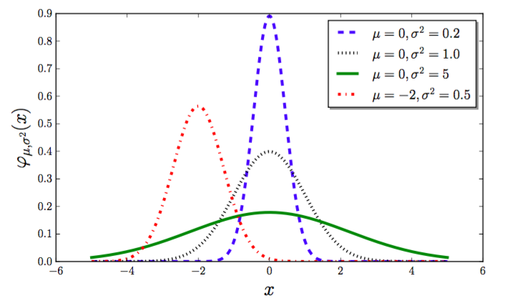
Parameters for Simulating Experiments :
The curve becomes smoother, i.e., has lower steepness with the growth of sigma; while in contrast, the peak of Gaussian curve is steeper when sigma being smaller.
5/18

Slide 7
New Analysis of Experimental Result

Slide 8
Indexes for Measuring Market Performance:
Price-oriented Indexes: Under most circumstances, a healthy market is supposed to possess currency with considerably stable price.
Price Slipping Ratio: The ratio of the number of time slots in which price drops at a certain rate to the number of all time slots.
(2) Transaction-oriented Indexes: To see whether Bancor protocol efficiently handle the problem of “Double Coincidence of Wants” and largely improve the market‘s liquidity.
Total Transactions’ Number: Launched transactions’ Number in total.
Transactions’ Cancel Ratio: Simulator requires that in every new time slot, the customer has to cancel the old transaction order if it has not been finished. Here we record the cancel ratio.
6/18

Slide 9
1. New Bancor Policy vs Old

Slide 10
Cancel Rates all increases, but not to 50%
7/18
Notes:
The reason the rate doesn’t climb to 50% is because:
Our Gaussian function creates discrete price valuations.
Our Market have considerably large reserve pool.
These means for instance, one customer has valuation $1 of the product, another has $1.1 (though close, but not the same)
After the first customer buying the product at $0.99, the price of product climbs to $1.05, which means the second customer with valuation $1.1 still can buy this product.
But as in the new Bancor policy, customers do not have a second chance in the same time step, therefore cancel rates all increase.

Slide 11
medium slip: 5%
8/18

Slide 12
2. Something Wrong with the old Classic Market’s Code

Slide 13
Old
New
Create a market;
Initialize the SmartToken, Market Pools and Order Stack;
For seed in [randomseeds]:
# simulate customers’ coming
…
For seed in [randomseeds]:
Create a market;
Initialize the SmartToken, Market Pools and Order Stack;
# simulate customers’ coming
…
The old one is wrong!!
As by old method, at every random seed’s turn, the Market’s Order Stack is not refreshed. Therefore, orders at the last time step in the Stack will be remained in the beginning of the next random seed’s turn.
This makes the cancel rate is extremely high under all-in policy’s case. As customers are easily to run out their money, there are many transactions unfinished in the market stack are inherited by the next random seed.
9/18

Slide 14
Wrong!!!
10/18

Slide 15
3. New Bancor vs Correct Old Classic (Customers cancel their unfinished orders and launch new orders in every time step )

Slide 16
Transaction’s Number decreases.
Reason: Some customers run out their money and cannot launch orders.
11/18

Slide 17
Bancor performs worse at most of the time. “Double coincidence…” might not exist nor be better solved by Bancor
The last one is the customer number is 500(small), sigma is 1(less closer valuation).
12/18

Slide 18
4. New Bancor vs New Classic (Customers wait for their unfinished orders, even to the end)

Slide 19
Transaction’s Number decreases.
Reason: Some customers run out their money and cannot launch orders.
13/18

Slide 20
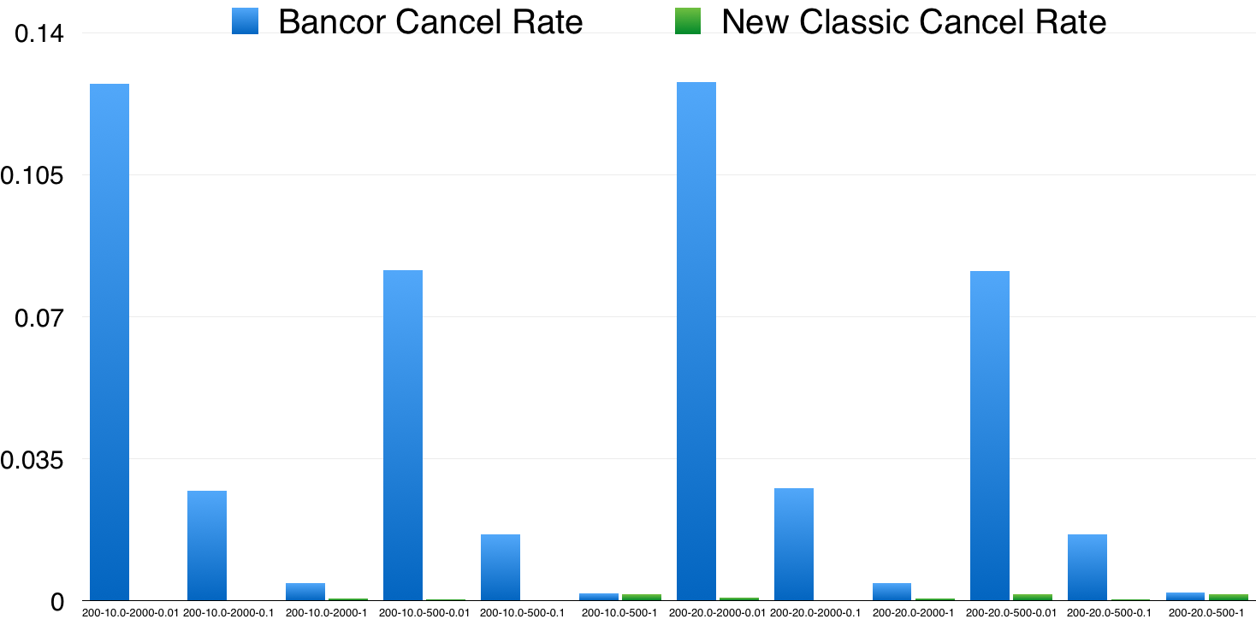
Bancor performs much worse all the time!
“Double coincidence…” might not exist nor be better solved by Bancor.
14/18

Slide 21
5. Old Classic vs New Classic (Customers wait for their unfinished orders, even to the end)

Slide 22
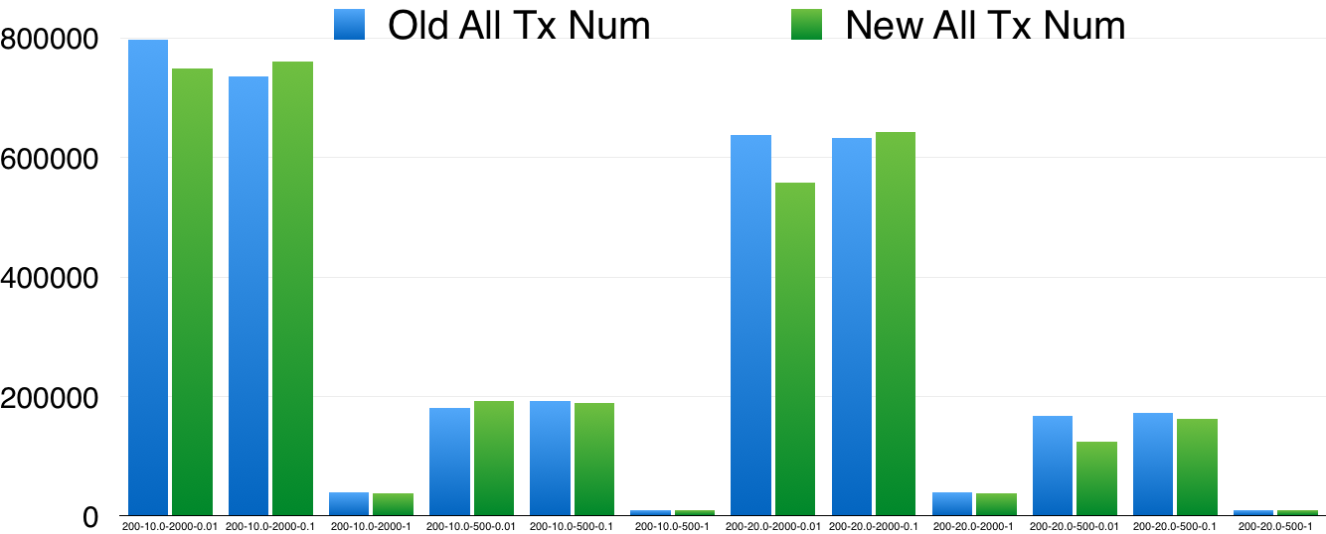
We might worry about the decrease of transaction numbers as customers choose to wait.
But the result shows the total transaction number almost the same.
15/18

Slide 23
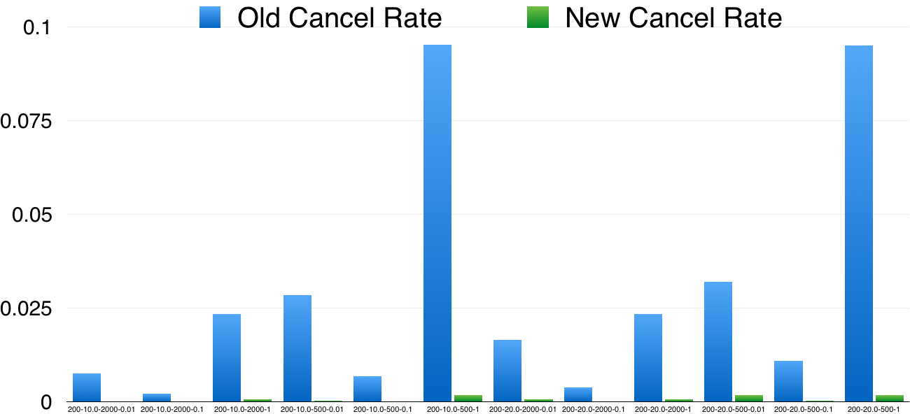
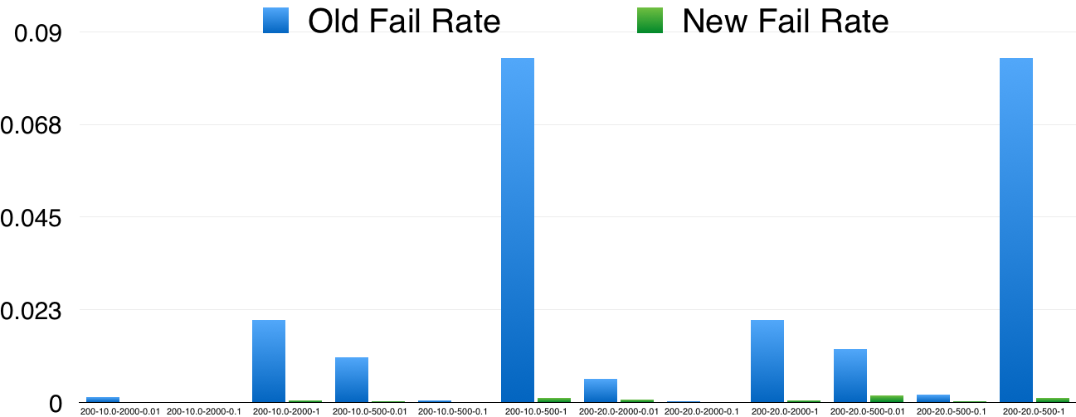
While new policy offers much smaller cancel rate and fail rate of orders.
16/18

Slide 24
Bancor is flawed
The problem of “Double Coincidence of Wants” Bancor wants to solve might not exist in real world. Even assuming this problem does exist, Bancor protocol fails to ensure its superiority compared with normal market.
The price of smart token, i.e. currency in Bancor protocol could fluctuate significantly, especially when customers generate close valuations of smart token, which might generate destructive effect on market.
Bancor protocol cannot fully process multiple transaction orders launched simultaneously, especially when market size is small.
17/18

Slide 25
Thanks!
18/18

